Slide 1
PAS Tools Department
PAS.Tools@emerson.com

Slide 2

Members
Supervisor
Alejandro Villalobos
Software Developer
Gregory Solano
Tool Champion
Eduardo Quesada
Software Developer
Jose Cedeño
Tool Champion
José Herra

Slide 3
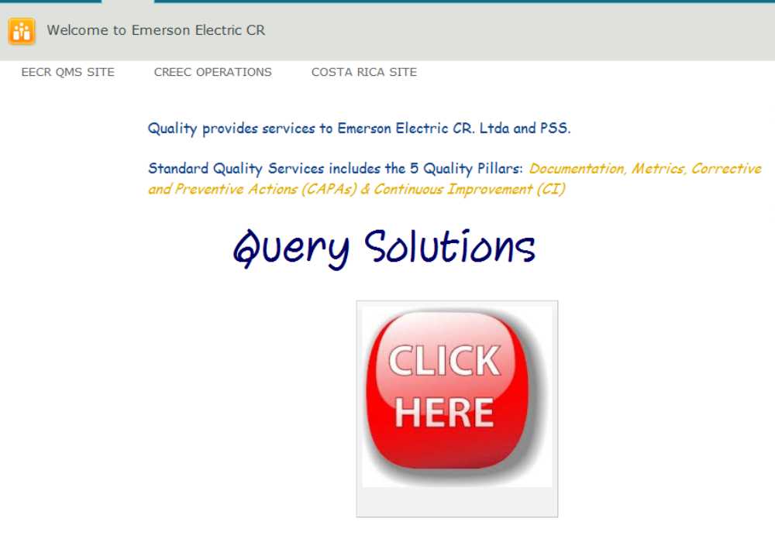
SharePoint

Slide 4
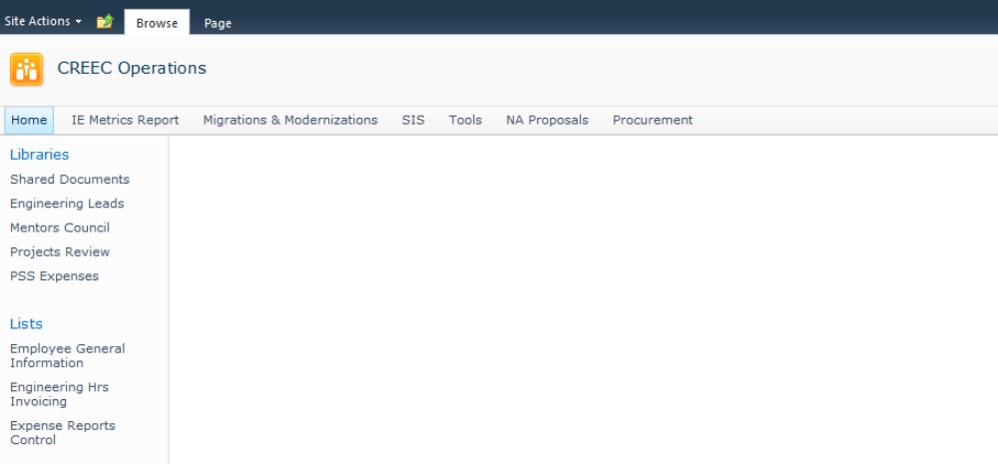
SharePoint

Slide 5
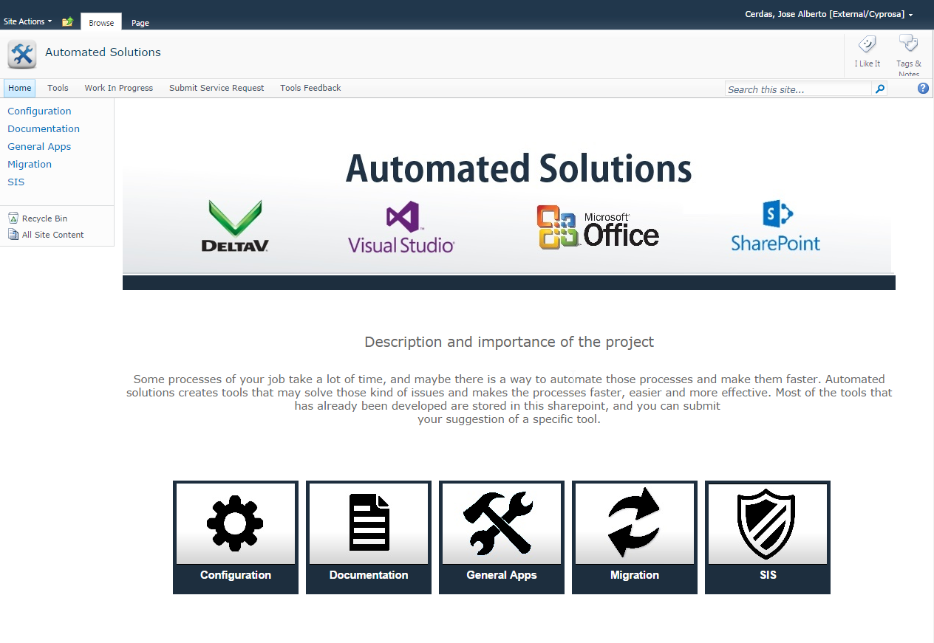
SharePoint
General navigation
File Links
File Links

Slide 6
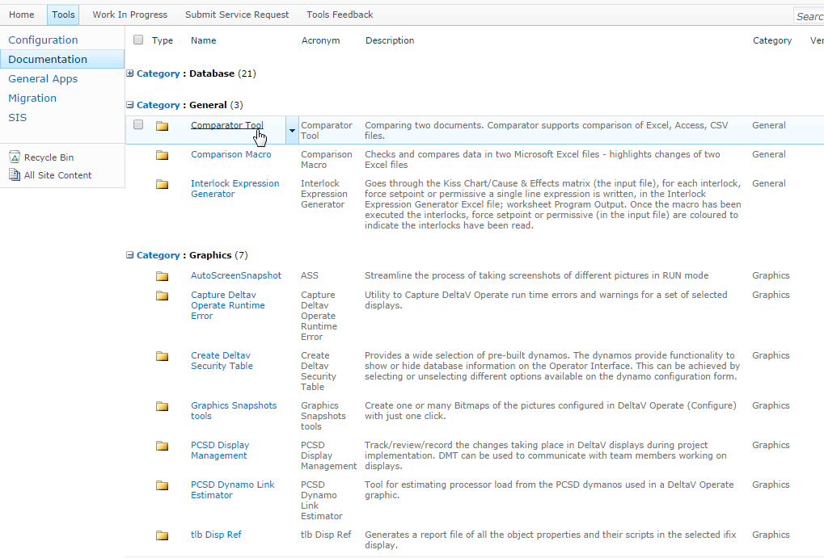
Tool Download
Show tool details
Tools list

Slide 7
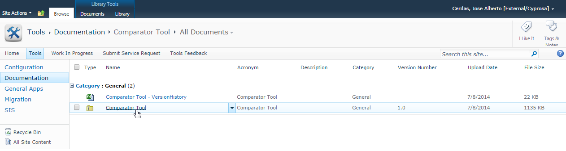
Tool Download
Files list
Download tool

Slide 8
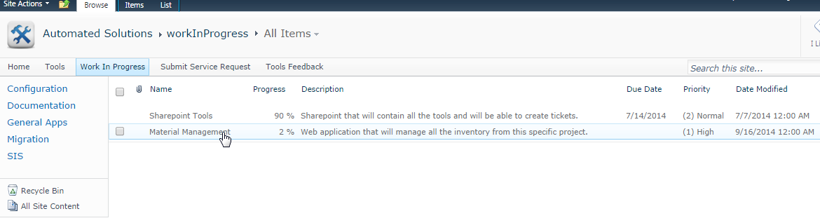
Work in Progress
Tool in progress details

Slide 9
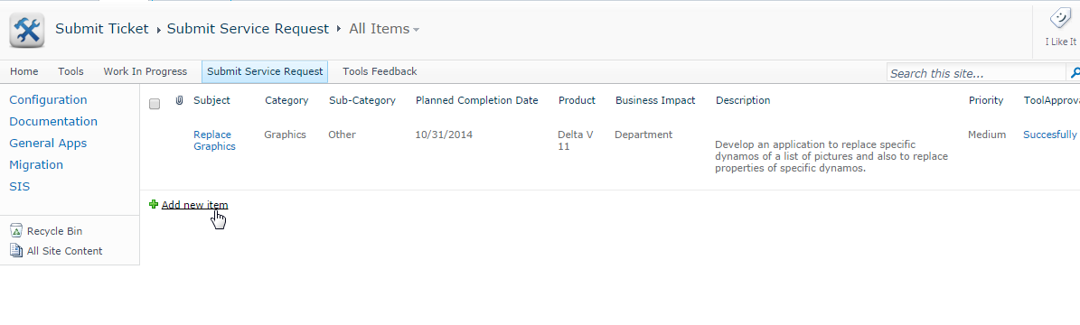
Submit Service Request
Tool in progress details
Tickets list
Submit new service request

Slide 10
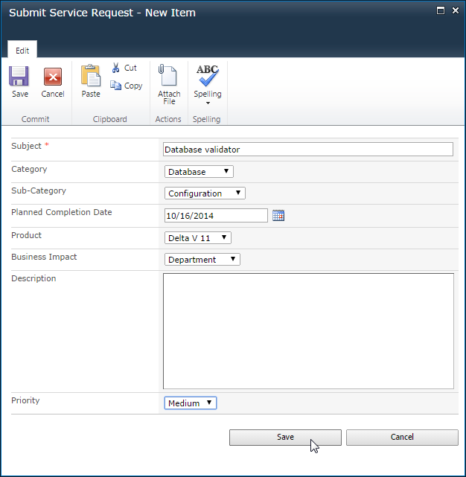
Submit Service Request
Tickets
details

Slide 11
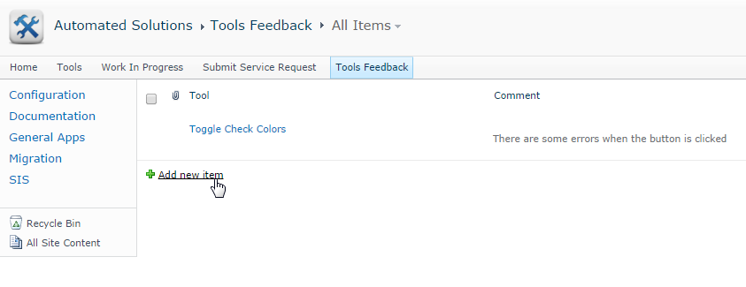
Tools Feedback
Feedback list
Send new feedback
*Ticket notifications will be handled via email.

Slide 12
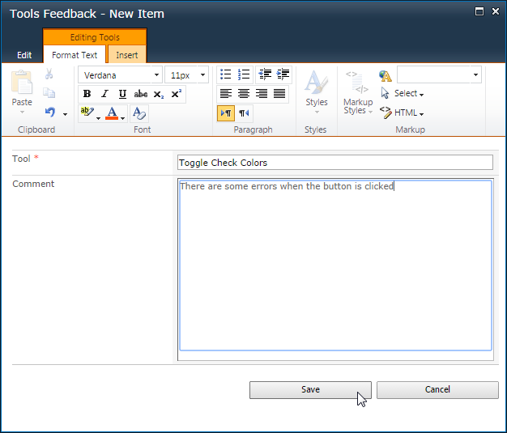
Tools Feedback
Feedback details

Slide 13
PAS Tools Department
PAS.Tools@emerson.com

